Slide 1



Capstone EDA 1
Airbnb NYC EDA Analysis
Project By- Sourabh Choudhary

Slide 2
Points of Discussion
What is Airbnb?
Data Summary
Data Cleaning
Neighbourhood Group Analysis
Room Type In each Neighbourhood
Most Busy Host
Most Number of Listings
About the most Busiest Host
Insights from the map
Prices for Different Room Type in different neighbourhood groups
Average Price in Each Neighbourhood
Average No. Of nights people stayed in each room type
Room Availability
Word Cloud
Conclusion

Slide 3

What Is Airbnb?
An Airbnb is a residential property that hosts rent on a short term basis to travelers. It can be anything from a house, a single room, a boat or even a tree house. Think of it as pop-up accommodation – a market place where people rent out their properties.
PEOPLE
PLACES
LOVE
=
AIRBNB

Slide 4
Data Summary
The dataset include listing activity of a metrics in NYC , for 2019.
This dataset contains prices for listing
In different neighborhood groups within different neighborhood cities.
It also contain different factor Like property type, reviews, and availability of listing; that can affect the price for the listing.
The data has 48895 observations and 16 attributes.
Explanatory variables: price, name host id , host name, neighborhood-group, neighborhood, latitude; longitude, room type, minimum-nights, no. of review, last review, review per month, calculated host listing, and availability 365 days.

Slide 5
Data Cleaning
Dropped all that column which was not useful for doing data analysis like Id, review from last month.
Also we have column name review per month which have 10052 null value. We need to make it zero for our analysis.
Column which is mandatory to take for the observation we Removed all the null values from the column.
Data with zero null value gives a accurate measures and help data analysts to give right suggestion to Airbnb.

Slide 6


Data Visualization And Insights

Slide 7
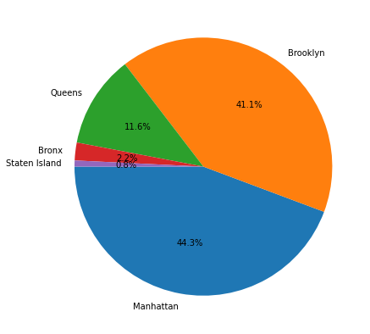
Neighbourhood Group Analysis
Graph shows the highest 44% hosts available in Manhattan
Graph shows the second highest 41% hosts available in Brooklyn
It can be clearly seen that majority of hosts are from these two areas alone
We need to work more on branding, discounts and offers in these two areas

Slide 8
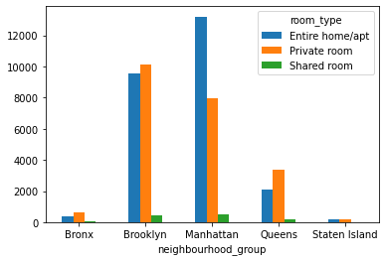
Room Type In Each Neighbourhood
Plot clearly says that shared room are least populated.
That most of the people select privacy and safety over the les-s price.

Slide 9
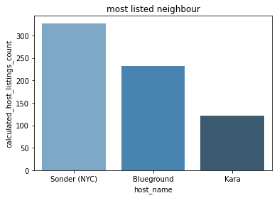
Most Busy Host
After doing some google research we found that sonder is hotel chain company which used airbnb for listing its property ,it's hotel is based on Manhattan

Slide 10
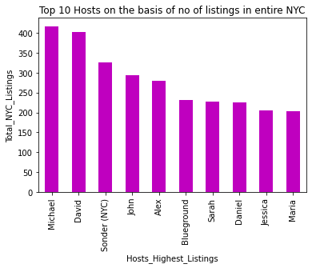
Most Number of Listings
Graph shows host name- Michael has the highest number of listings in whole NYC. & then host name -David has second highest listings

Slide 11
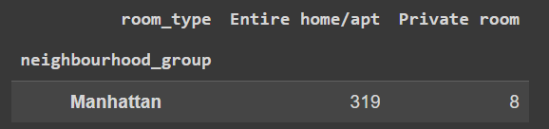
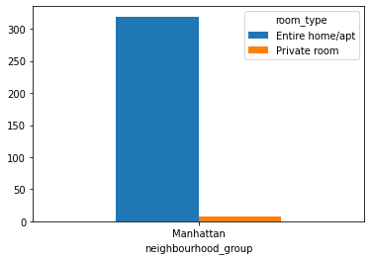
About The Most Busiest Host
In Sonder (NYC) have 327 listing.
All listing are available in "Manhattan" only.
Sonder (NYC) have 319 Entire home/apt.
And Sonder (NYC) have 8 Private room

Slide 12
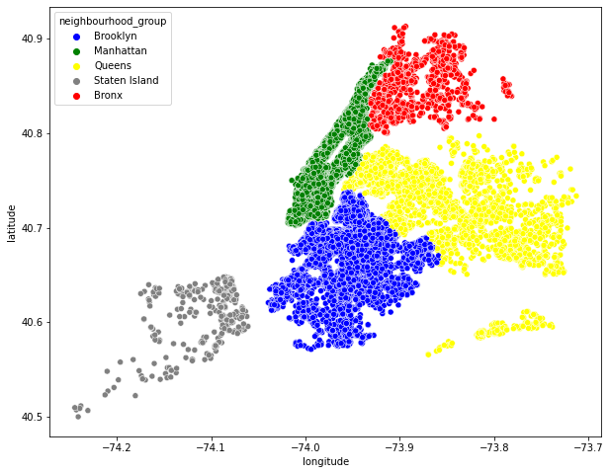
Insights From The Map
Most Airbnb is located in Manhattan and Brooklyn. Due to capital income state Manhattan is most Expensive.

Slide 13
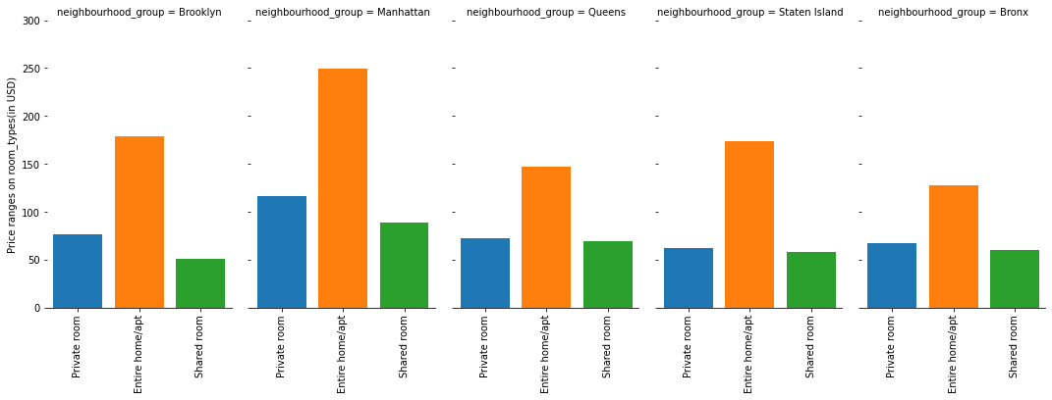
Prices for Different Room Type in Different Neighbourhood Groups
Manhattan area has the highest price for room types with Entire home/apt ranging to nearly 240 USD/night, followed by Private room with 110 USD/night. From this we can state that Manhattan areas is costliest area to live.

Slide 14
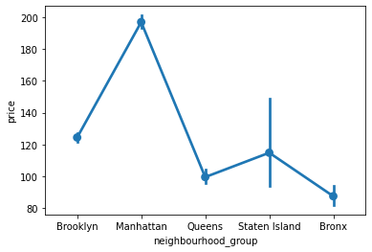
Average Price in Each Neighbourhood
The above graph conclude that avg price(in USD) for most Costliest place Manhattan is almost 200$. Cheapest place Bronx avg price is 90 USD.

Slide 15
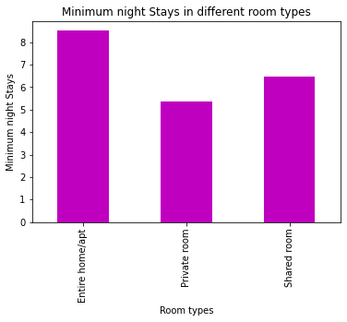
Average No. Of nights people Stayed in each Room Type
Looking at these it clearly indicates that people mostly prefer living in an entire home/apt on an average of more than 8 nights followed by guests who stayed in shared room where average stay is 6-7 nights.

Slide 16
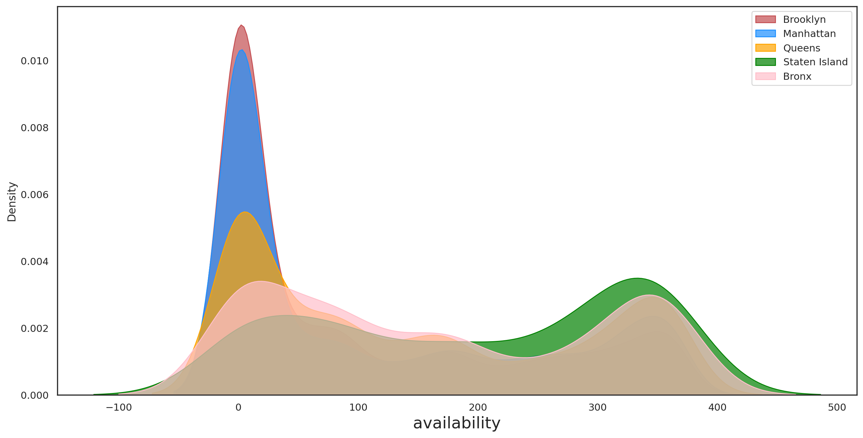
Room Availability
This KDE Graph shows us the availability in the neighborhood of NYC
We get to know that Staten Island and Bronx has more probability of available 365 days

Slide 17
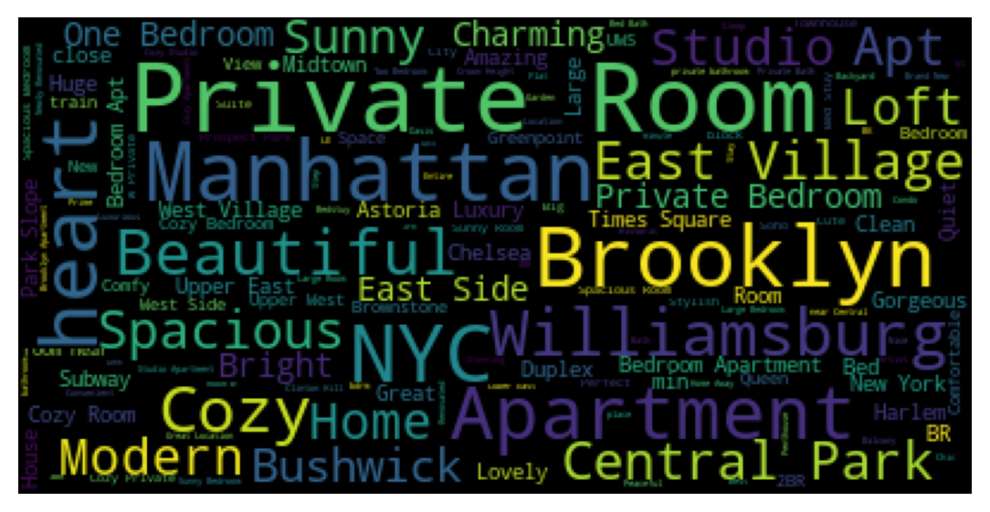
Word Cloud
We have extracted some information from the listing names. With word cloud (as shown in the following figure) we can see the top words are: 'Private Room', 'Brooklyn’ ,'Manhattan’, 'Apartment', 'Spacious', 'Modern', 'Beautiful' etc. This shows that there are no catchphrases or 'popular/trending' terms that are used for names; hosts use very simple terms describing the space and the area.

Slide 18
Conclusion
This Airbnb (NYC 2019) Dataset For The Year 2019 Appeared to be a very rich Dataset with a variety of columns that allowed us to do deep data exploration
People usually go for Entire home/apt or Private room and Graniteville neighborhood has the mean minimum price among all neighborhood's
Shared rooms does have not have a high traffic whereas Entire home/apt and Private rooms are high in demand. Most busiest top 10 host's offers Entire home/apt and Private room in higher percentage so this could be the one reason of being most busiest hosts.
Manhattan is the busiest neighborhood place as the minimum night spend is maximum compared to others. So, if people are not staying more then one night means they are travelers. From the above analysis we can conclude that most of the people choose entire home apartment as their first choice.

Slide 19
Thankyou…

